Slide 1




TEAM 2
EDU CONSULTANCY
SYSTEM

Slide 2


TEAM MEMBERS
MENTOR
Pravin Singh Charan
Arjun Mohanty
Praveena B
Komal Vadaskar
Kusuma
Sanjeev G

Slide 3
INTRODUCTION
The Edu Consultancy System is a user-friendly solution designed to simplify communication and planning between students, parents, and educational consultants.
Users can effortlessly view, and manage courses with consultants, ensuring a smooth and hassle-free experience for both students and service providers.
This intuitive application empowers students to make informed decisions about their educational journey, while consultants and administrators benefit from tools to enhance planning and training programs.

Slide 4


Project Overview
USER FEATURES
CREATE A NEW USER ACCOUNT TO ACCESS THE APPLICATION.
LOGIN WITH YOUR USERNAME AND PASSWORD.
SEARCH FOR AVAILABLE COURSES ACCORDING TO THE CATEGORY AND REQUIREMENT
MAKE A PAYMENT BY SELECTING YOUR PREFERRED COURSE AND PROVIDING PAYMENT DETAILS..
CUSTOMIZE YOUR BLOG, FEED BY SELECTING PREFERRED CATEGORIES AND TOPICS.
FEEDBACK USERS CAN SHARE THEIR THOUGHTS AND SUGGESTION TO IMPROVE OUR SERVICE.

Slide 5
Project Overview
USER FEATURES
CREATE A NEW USER ACCOUNT TO ACCESS THE APPLICATION.
LOGIN WITH YOUR USERNAME AND PASSWORD.
SEARCH FOR AVAILABLE COURSES ACCORDING TO THE CATEGORY AND REQUIREMENT
MAKE A PAYMENT BY SELECTING YOUR PREFERRED COURSE AND PROVIDING PAYMENT DETAILS..
CUSTOMIZE YOUR BLOG, FEED BY SELECTING PREFERRED CATEGORIES AND TOPICS.
FEEDBACK USERS CAN SHARE THEIR THOUGHTS AND SUGGESTION TO IMPROVE OUR SERVICE.

Slide 6
Project Overview
ADMIN FEATURES
LOGIN WITH THE APPLICATION TO MANAGE THE USERS.
ADD NEW USERS TO THE APPLICATION WITH EASE FOR STREAMLINED ACCESS AND MANAGEMENT.
MANAGE PAYMENT DETAILS OF THE USERS,ENSURING ACCURATE PROCESSING AND RECORDS.
VIEW EXISTING USERS, COURSE DETAILS AND PAYMENTS
DELETE USERS WHOSE COURSE HAVE BEEN COMPLETED TO MAINTAIN UPDATED DATABASE.

Slide 7
MILESTONE
Payment Interface provides users with a seamless experience to easily enter payment details, select payment methods, and complete transaction.It supports various payment options, including credit/debit cards, UPI,ensuring convenience and flexibility for all users.
The application allows users to register, log in, and verify email addresses, with password reset functionality and security measures to protect user data.
3
1
2
Blog interface categorized by topics, allowing users to easily explore content and product page allowing the user to check the course details
4
Product subscription management, allowing users to easily subscribe to courses. Automated email notifications and alerts were integrated for successful payments. An admin dashboard to manage subscriptions, add or delete users.

Slide 8
REQUIREMENT SPECIFICATION
HARDWARE REQUIREMENT :
Intel i3 CPU or higher.
Hard disk-20GB.
RAM-2GB or more.
Windows 7 (64-bit) or higher/ MacOS(64-bit) or higher,
SOFTWARE REQUIREMENT :
Spring Boot .
React
IntelliJ IDEA
MySQL
Chrome,safari or other browser.

Slide 9
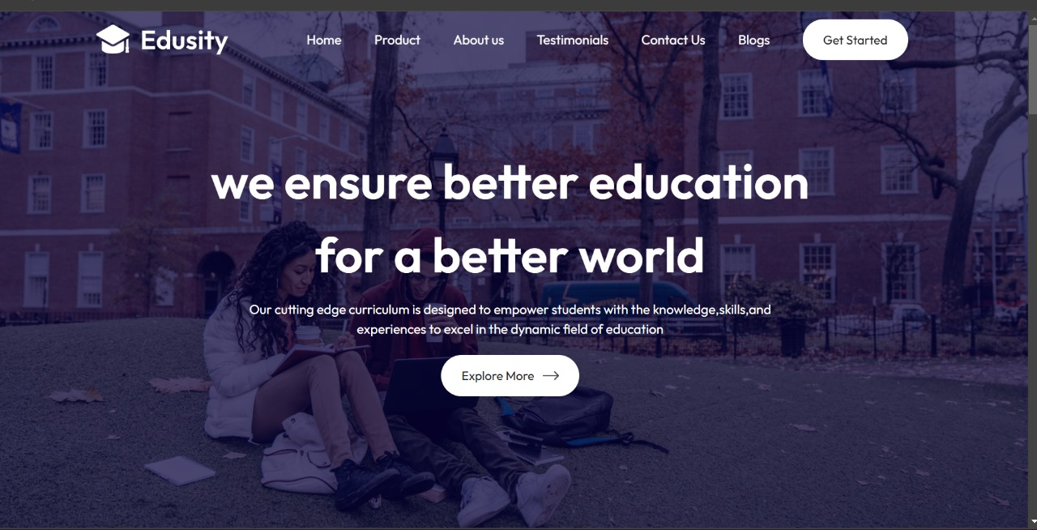
Landing Page

Slide 10
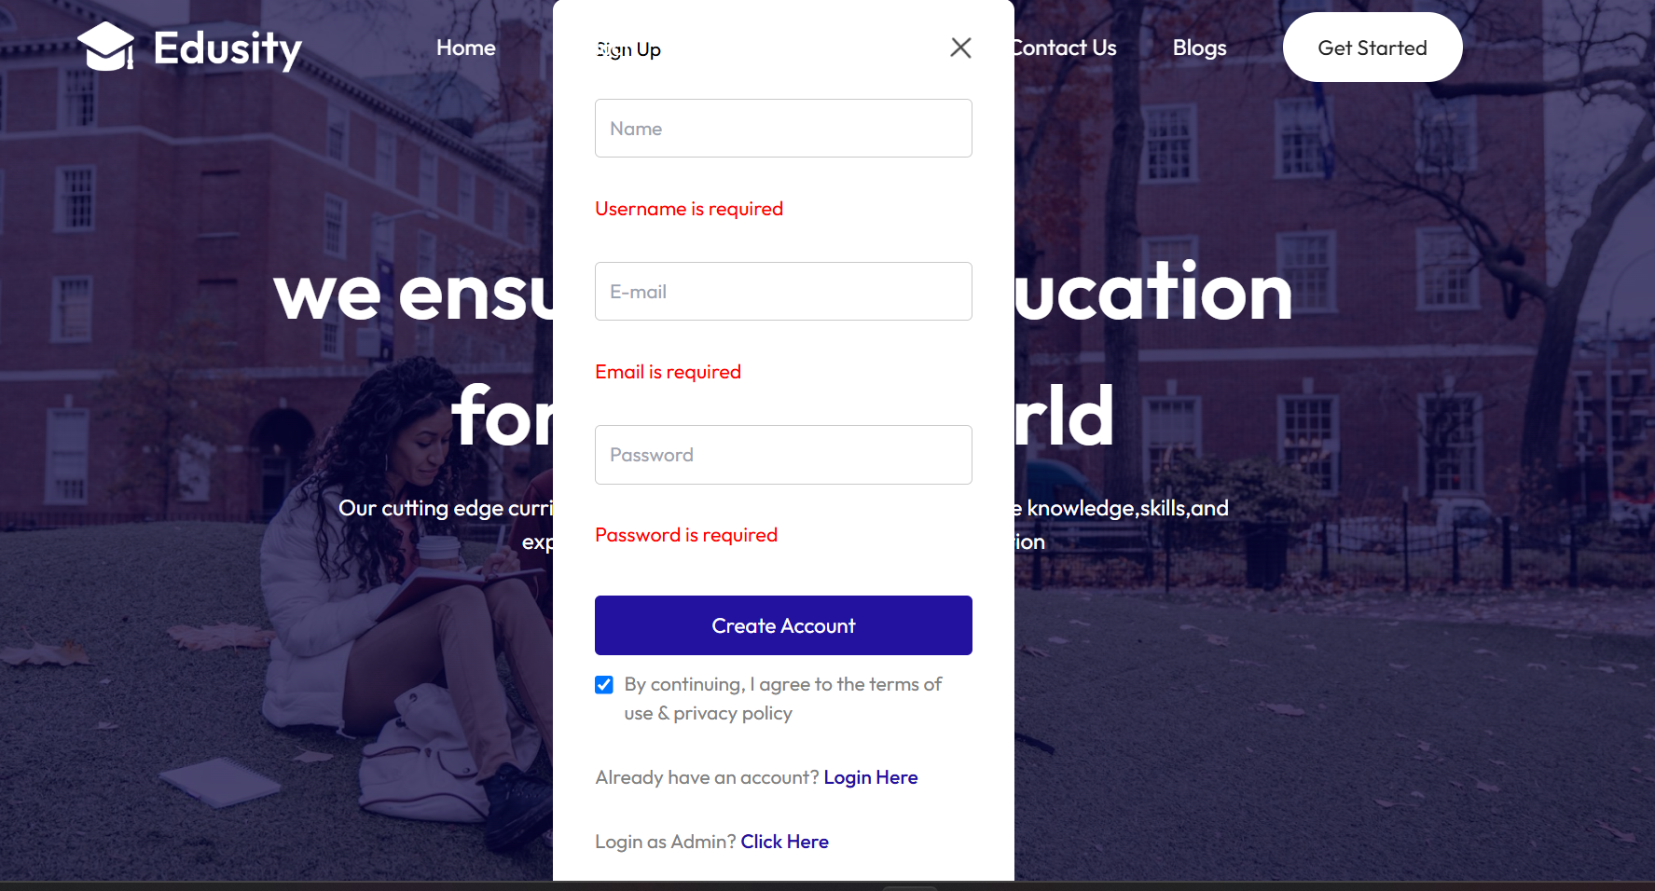
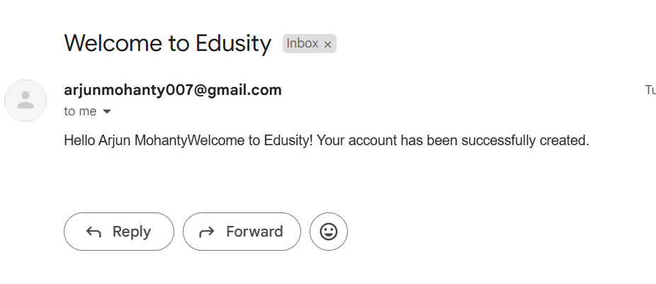
User Registration

Slide 11
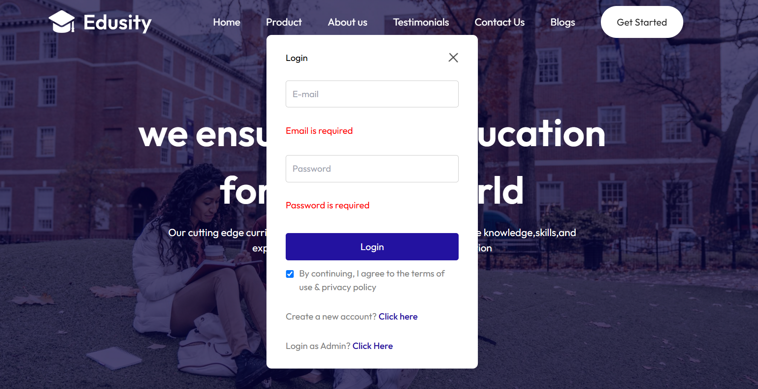
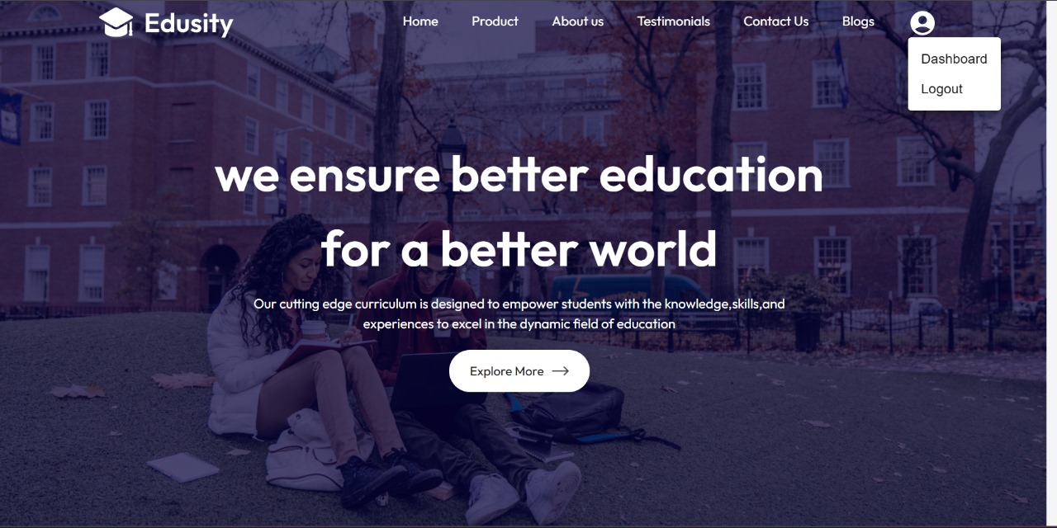
Login

Slide 12
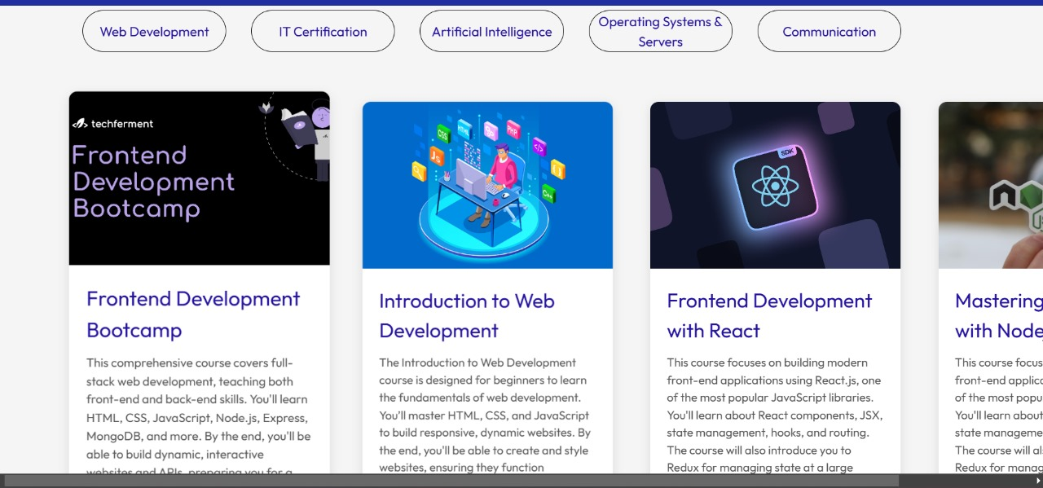

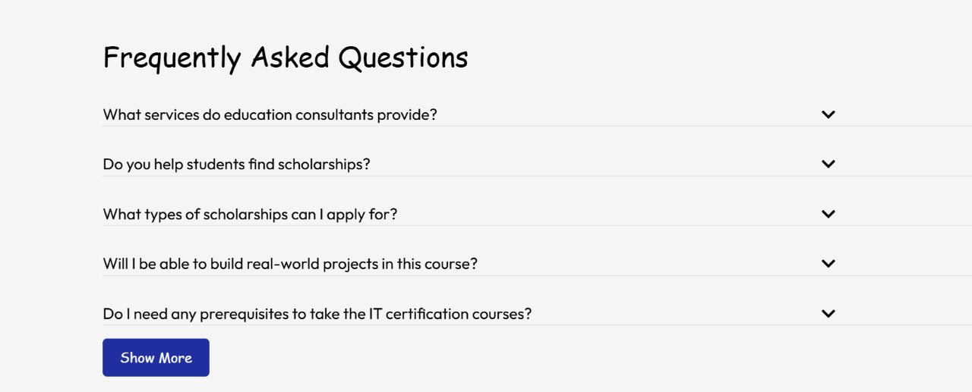
;
Product

Slide 13
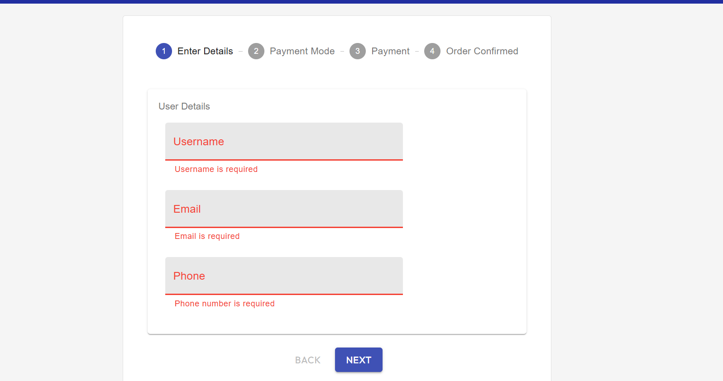
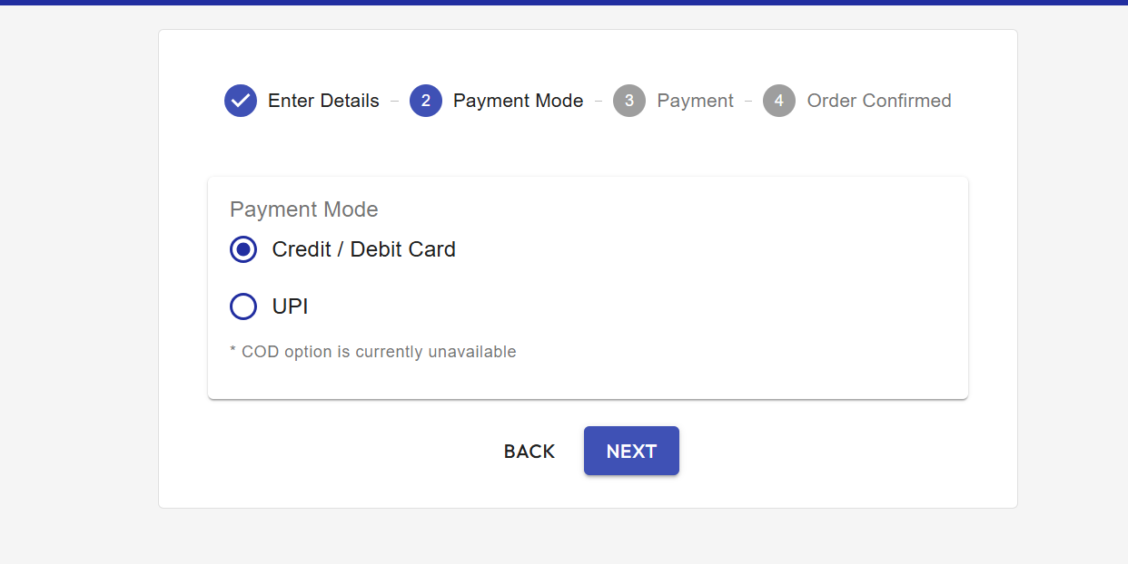
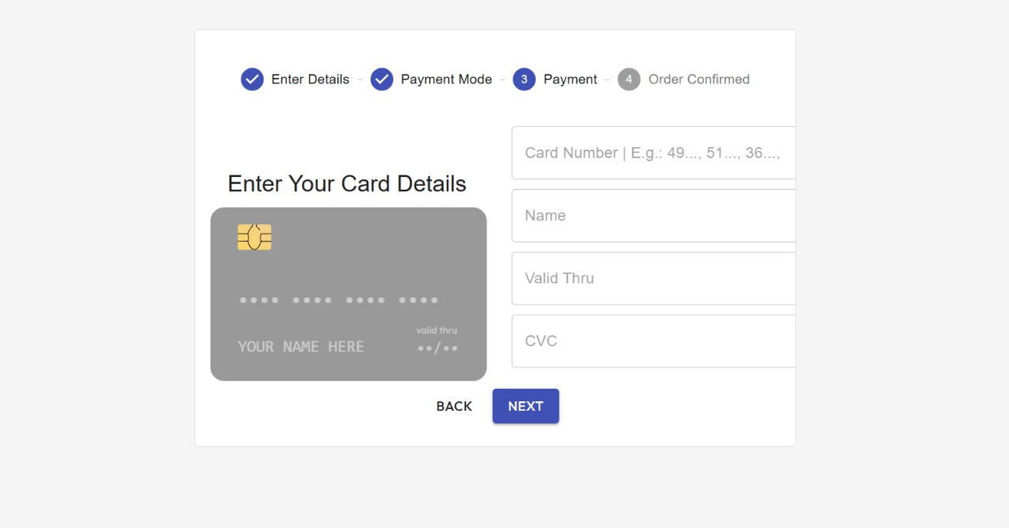
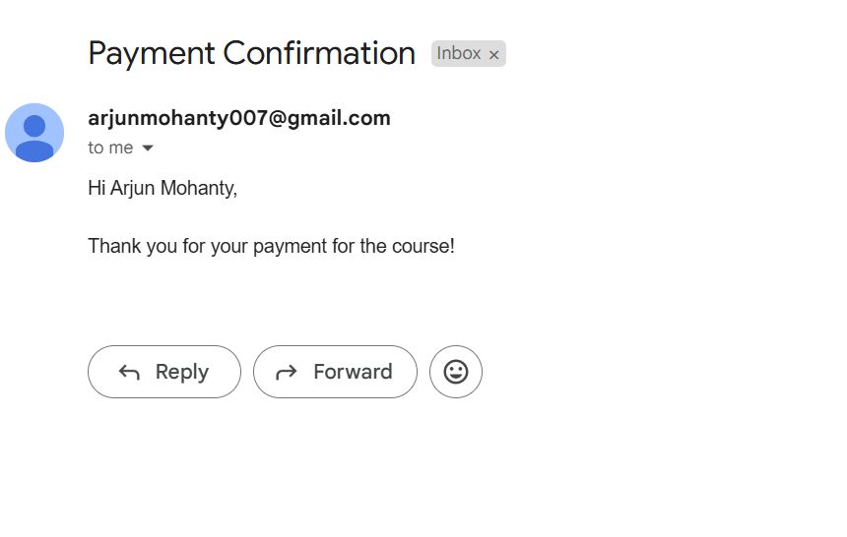
;
Payment

Slide 14
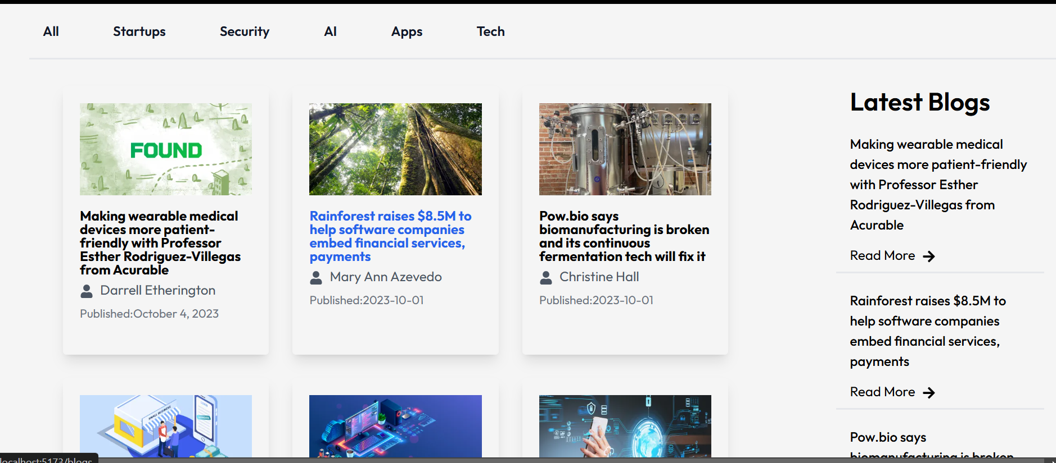
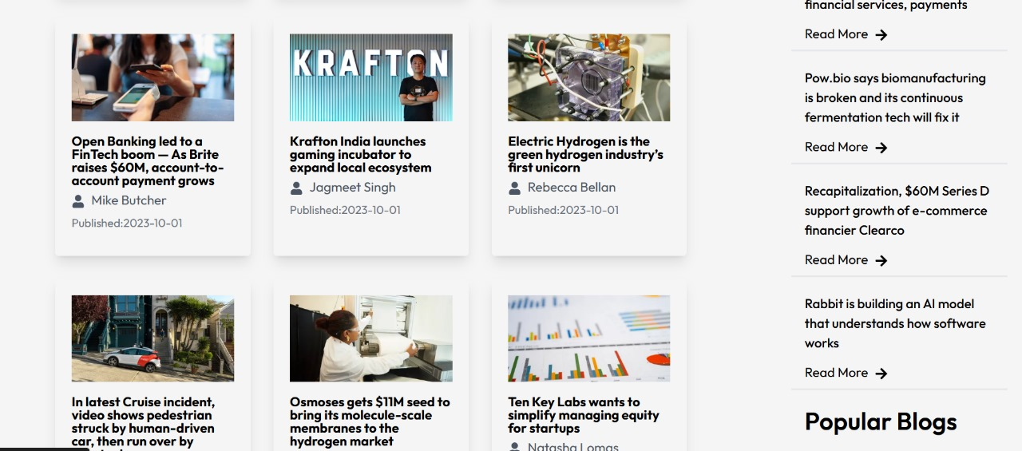
;
Blogs

Slide 15

;
About Us

Slide 16
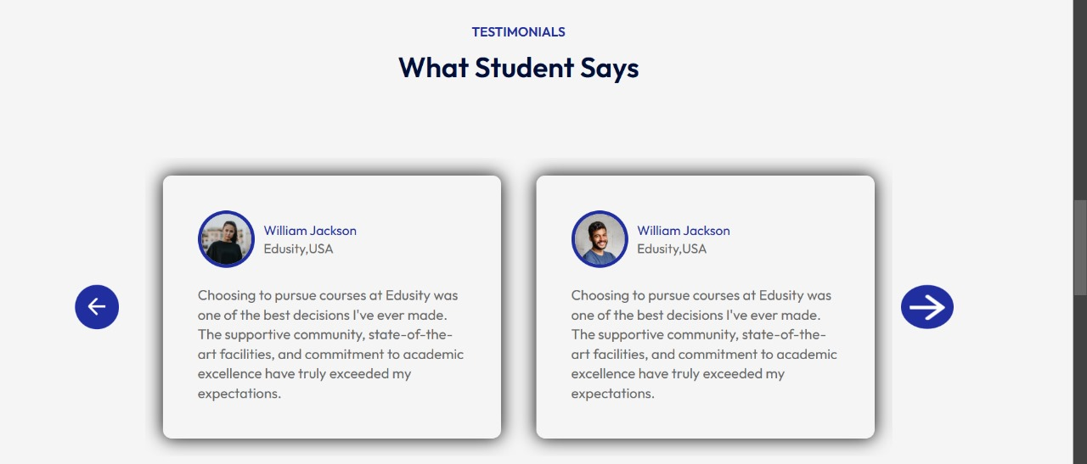
;
Testimonials

Slide 17
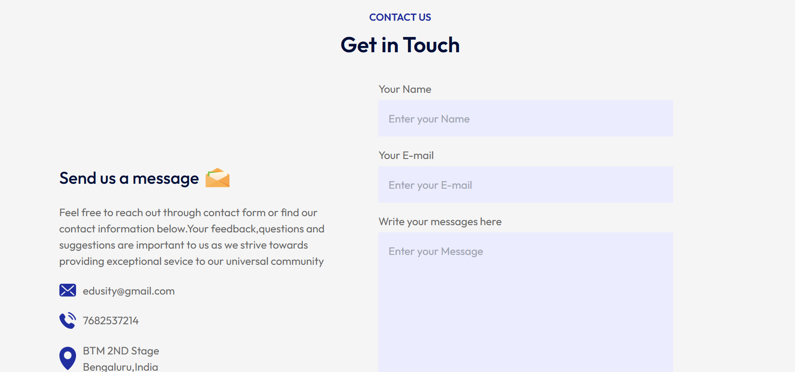
;
Contact Us

Slide 18
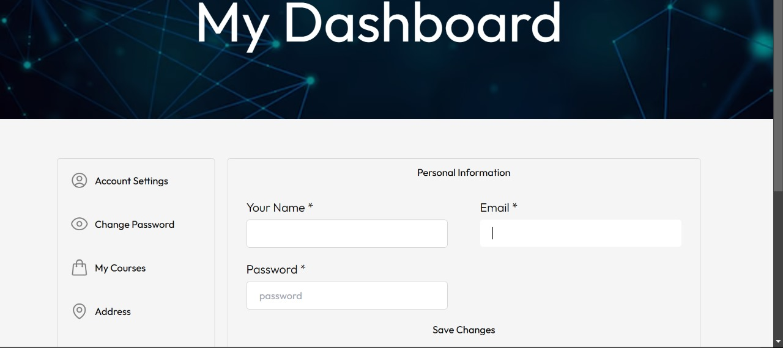
;
Dashboard

Slide 19
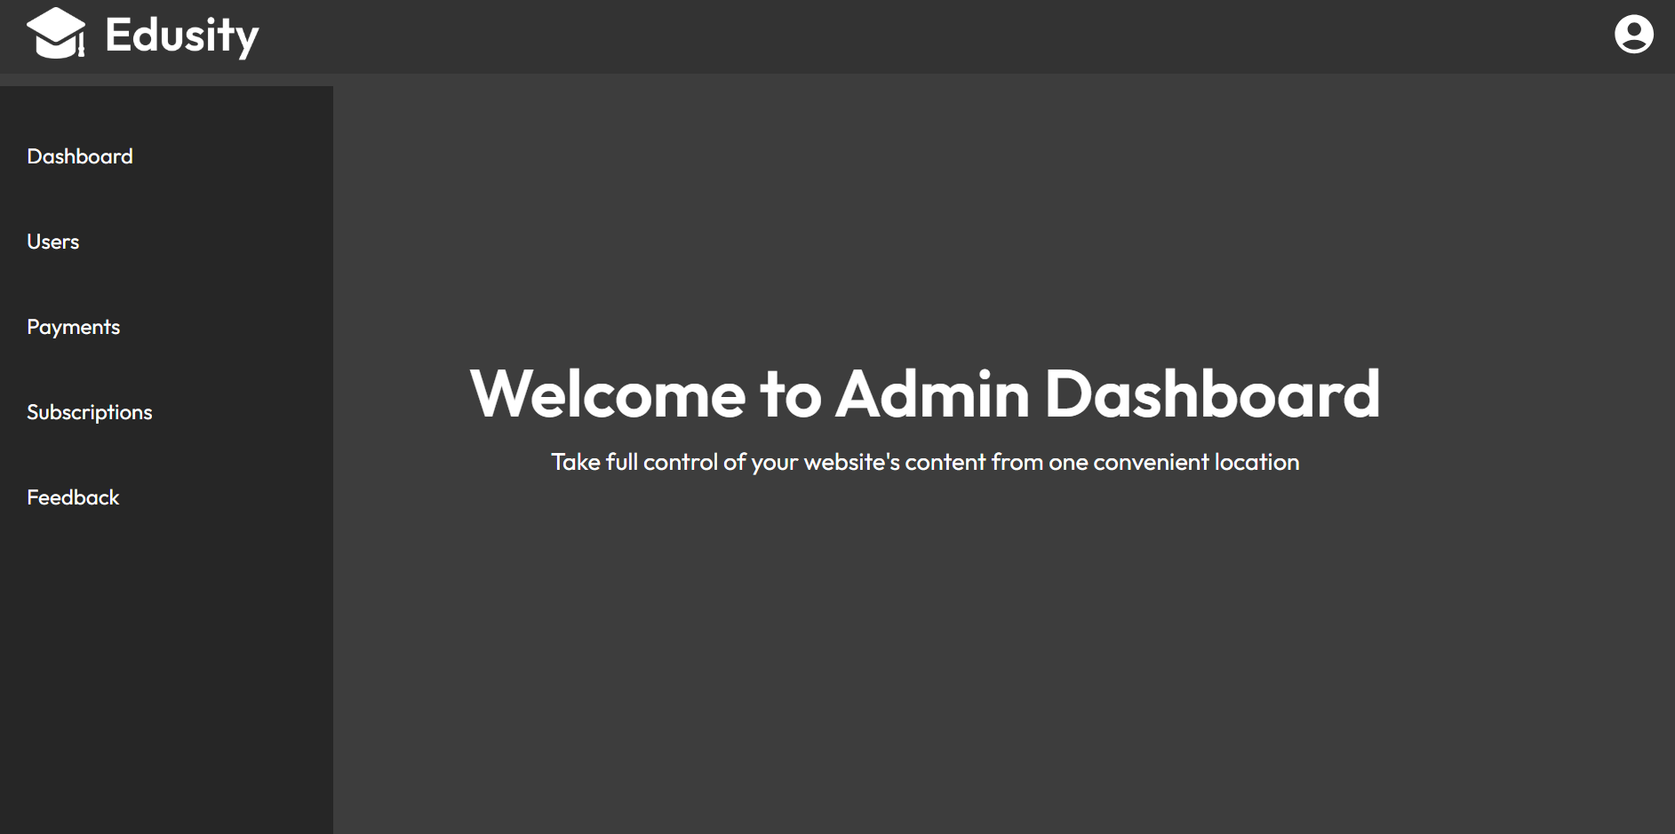
;
Admin Dashboard

Slide 20
CONCLUSION
The Edu Consultancy System is a comprehensive solution designed to streamline educational planning and guidance for students and admin.
Students can create accounts, manage subscriptions with ease. Administrators can manage user data, payments, and monitor subscription statuses through a dedicated dashboard.
The system enhances user experience with automated notifications, role-specific dashboards, and blogs content, making it a seamless and efficient platform for educational consultation

Slide 21


